Slide 1

Diabetes Prediction Using Machine Learning
Diabetes Prediction Using
Machine Learning
Submitted By - Abhishek Sawant (PGA- 48)

Slide 2
Index
Abstract
Introduction
Objective
Problem Statement
Tools and Platform Used
Dataset Description
Variable Description
Exploratory Data Analysis (EDA)
Methodology
Model Building
Model Performance
Conclusion
Challenges Found

Slide 3
Abstract
Diabetes mellitus is a pervasive health condition with significant global implications, often detected too late for optimal intervention. Traditional diagnostic methods are typically invasive and time-consuming, underscoring the need for a more efficient predictive approach.
This study explores the development of a machine learning model to predict the risk of diabetes. By analyzing large datasets that include medical records and lifestyle factors, the model identifies patterns and risk indicators associated with diabetes. The ultimate goal is to enable early detection and intervention, thereby improving patient outcomes and reducing healthcare costs. This innovative approach demonstrates the potential of machine learning in enhancing preventive healthcare strategies.

Slide 4
Introduction
Diabetes is a widespread chronic disease characterized by high blood sugar levels, which, if left undiagnosed or untreated, can lead to severe health complications. Early detection is vital for effective management and prevention of these complications.
Machine learning, a branch of artificial intelligence, offers a powerful tool for predicting diabetes by analyzing vast amounts of health data. By identifying patterns and correlations within this data, machine learning models can provide accurate predictions of diabetes risk based on factors such as medical history, lifestyle, and genetic predisposition.
In the proposed system, an efficient way of detecting diabetes is proposed through machine learning. Under machine learning, we used the algorithm such as Logistic regression , Decision tree, Random forest, k-nearest neighbour, SVM, Gradient Boosting.
The experiment results shows that the prediction of diabetes done at high accuracy.

Slide 5
Objective
Develop a machine learning model for diabetes prediction.
Gather and preprocess diverse datasets including medical records and lifestyle factors.
Feature engineer relevant variables to enhance predictive accuracy.
Select and train appropriate machine learning algorithms for diabetes risk assessment.
Evaluate model performance using metrics such as accuracy, precision, recall, and F1-score.
Develop a user-friendly interface for healthcare professionals to input patient data and obtain risk predictions.
Validate the model's predictions against real-world patient data.
Implement continuous monitoring and model refinement for improved accuracy and reliability
over time.

Slide 6
Problem Statement
This project aims to develop a machine learning model to predict diabetes risk. By analyzing medical records and lifestyle factors, the model seeks to identify high-risk individuals early, enabling timely intervention and improved patient outcomes.

Slide 7





Tools And Platform Used
Tools: Python
Platform : Jupyter Notebook
Library Used : Numpy , Pandas , Matplot , Seaborn.

Slide 8
Data Description
Dataset: The dataset used for this project is the Diabetes Prediction Dataset, which comprises a comprehensive collection of medical and demographic data from patients, along with their diabetes status (positive or negative). The dataset encompasses several essential features including age, gender, body mass index (BMI), hypertension, heart disease, smoking history, HbA1c level, and blood glucose level.
Source: Kaggle
 | gender | age | Hypertension | heart_ disease | smoking_history | bmi | HbA1c_level | blood_ glucose_ level | diabetes
0 | 0 | 80.0 | 0 | 1 | 4 | 25.19 | 6.6 | 140 | 0
1 | 0 | 54.0 | 0 | 0 | 0 | 27.32 | 6.6 | 80 | 0
2 | 1 | 28.0 | 0 | 0 | 4 | 27.32 | 5.7 | 158 | 0
3 | 0 | 36.0 | 0 | 0 | 1 | 23.45 | 5.0 | 155 | 0
4 | 1 | 76.0 | 1 | 1 | 1 | 20.14 | 4.8 | 155 | 0

Slide 9
Variable Description
Gender: Gender refers to the biological sex of the individual, which can have an impact on their susceptibility to diabetes.
Age: Age is an important factor as diabetes is more commonly diagnosed in older adults . Age ranges from 0-80 in our dataset.
Hypertension: Hypertension is a medical condition in which the blood pressure in the arteries is persistently elevated.
Heart Disease: Heart disease is another medical condition that is associated with an increased risk of developing diabetes.
Smoking History: Smoking history is also considered as a risk factor on Diabetes. It represents smoking history of the patient.
BMI(Body Mass Index): BMI (Body Mass Index) is a measure of body fat based on weight and height. Patients with higher BMI are known for having more risk of suffering from diabetes.
HbA1c Level: HbA1c (Hemoglobin A1c) level is a measure of a person's average blood sugar level over the past 2-3 months.
Blood Glucose Level: Blood glucose level refers to the amount of glucose in the bloodstream at a given time.
Diabetes: Diabetes is the target variable being predicted, with values of 1 indicating the presence of diabetes and 0 indicating the absence of diabetes.

Slide 10
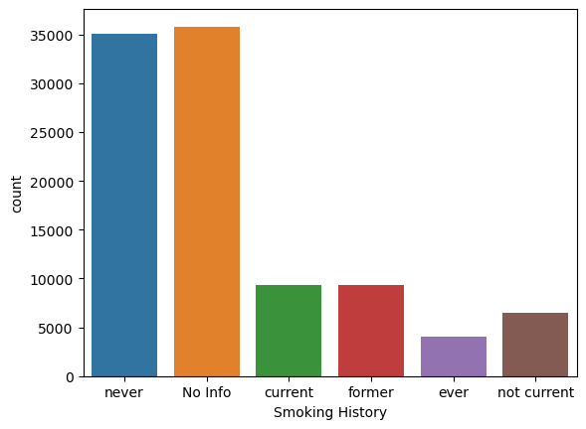
EXPLORATORY DATA ANALYSIS (EDA)
There is 'No Info' about almost 36000 people whereas 35000 people have never done smoking.

Slide 11
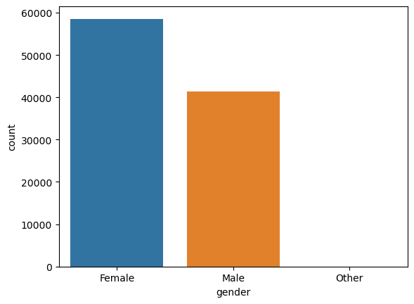
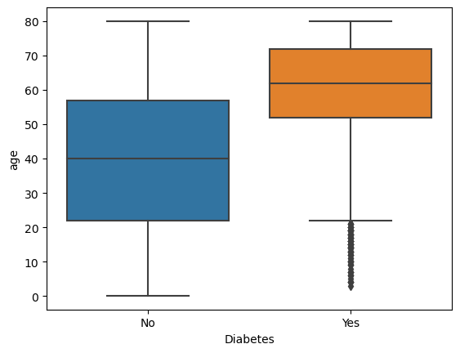
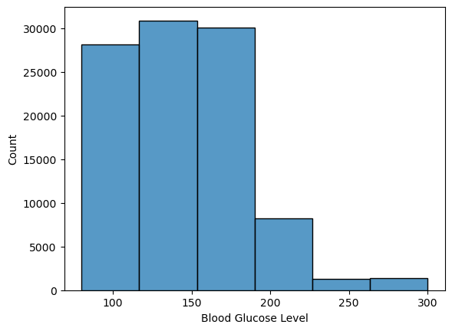
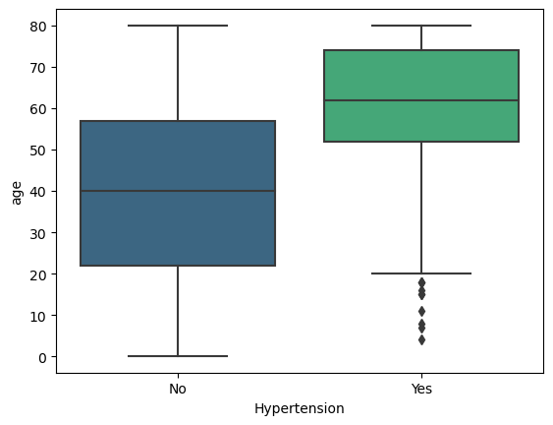
Average age of people who have diabetes is 60 and who don't have is 40.
This shows as the people age goes above 50 tend to get Diabetes.
There is almost 18% difference between Females and Males.
Also there is gender title as Other.
Averagely people have 100-200 Blood Glucose Level whereas some have 200-300.
Average age of people who have hypertension is 60 and who don't have is 40.
# This shows as the people age goes above 50 people start having hypertension issue.

Slide 12
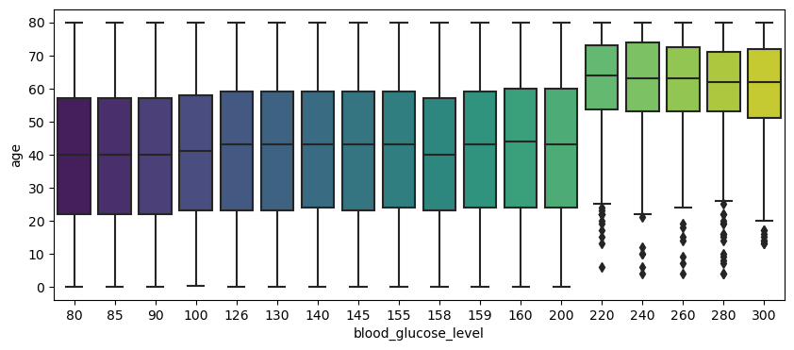
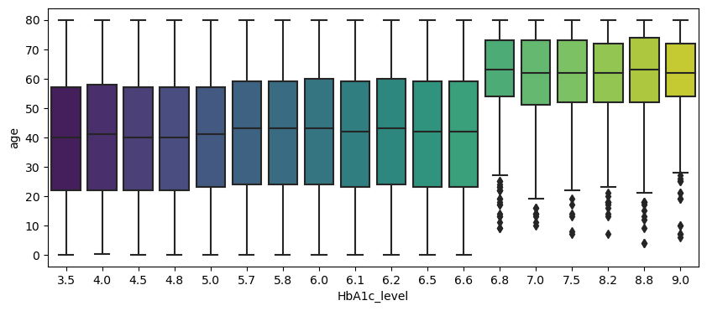
Average glucose level in blood is between 80-200 in the people with age group 20-50.
but people with more than 50 years have glucose level from 220-300.
The average age of people with HbA1c level 3.5-6.6 is 40, but it rises from 6.8-9.0 in older people whose average age is 60.

Slide 13
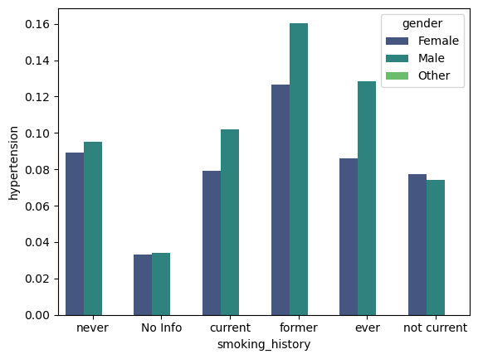
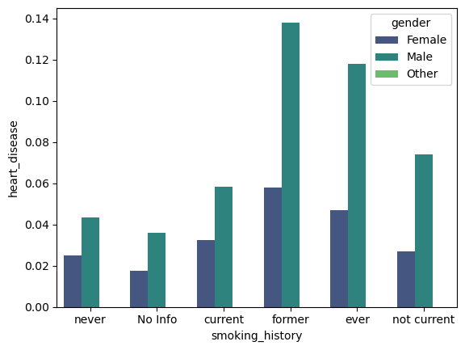
Former Smokers are facing high hypertension in regard of all other peoples who have smoking history.
And males have higher hypertension than females.
People who are former and regular smokers have high rate of heart disease
and out of those males have very high chance of getting heart disease.

Slide 14
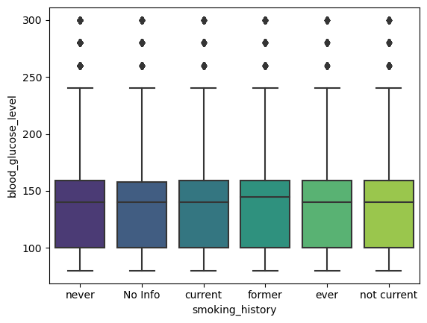
There is not much difference in glucose level of with respect of smoking history.

Slide 15
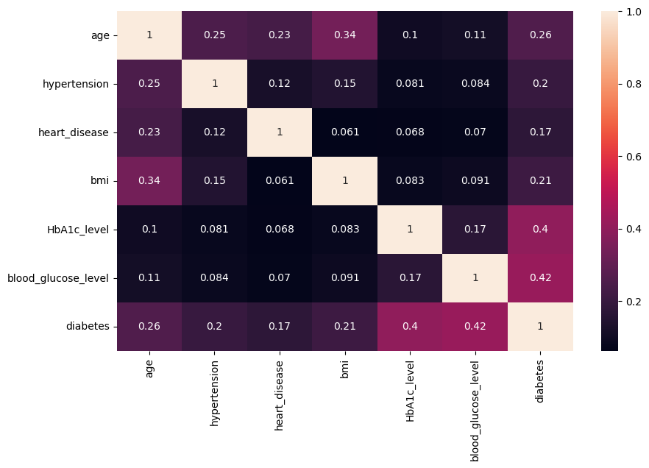
As we can see on the heat map, HbA1c Level and Blood Glucose Level is correlated with having diabetes.
This might help us track a pattern of our data distribution.
In fact, every other feature is correlated with diabetes, but the correlation level is not high like the mentioned features.

Slide 16
Methodology
Dataset
Collection
Dataset
Visualization
Split
(Train 80%)
(Test 20%)
Apply Machine Learning Algorithms
Evaluate Results

Slide 17
Model Prediction
We are going to apply few different machine learning models from SK-Learn Library. We'll use following:
Logistic Regression
Decision Tree Classifier
Random Forest Classifier
K-Nearest Neighbors
Support Vector Machines(SVM)
Gradient Descent

Slide 18
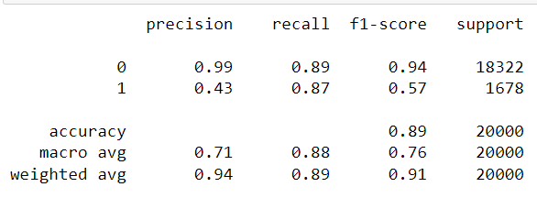
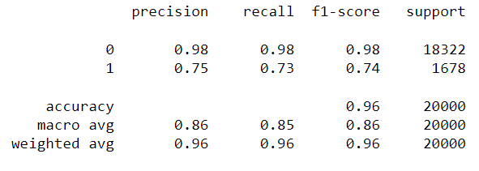
Logistic Regression
Decision Tree

Slide 19
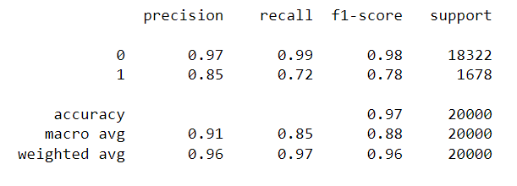
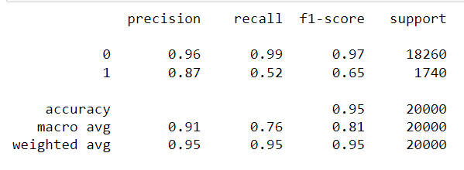
Random Forest
K-Nearest Neighbour

Slide 20
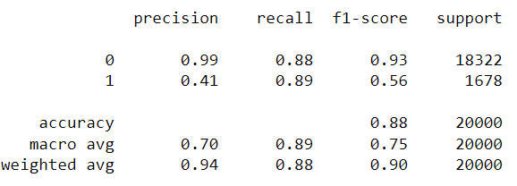
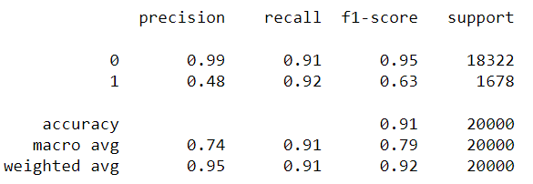
Support Vector Machine
Gradient Boosting

Slide 21
Conclusion
We have done a full examination on a dataset related to diabetes.
We have described the features of the dataset.
We have visualized our dataset for better inspection and decision.
We have applied 6 different machine learning algorithms on our dataset and found out the Random Forest has the highest Accuracy 97% for the dataset.
By continuously refining these models and addressing ethical considerations, we can enhance their reliability and effectiveness, ultimately leading to better patient outcomes and more efficient healthcare systems.

Slide 22
Challenges Found
Challenges in Utilizing Machine Learning with the Given Dataset:
Identifying relevant features.
Handling class imbalance.
Handling missing values.
Choosing the right algorithm.
Identifying important features.

Slide 23
THANK YOU !!

